Slide 1

Instrumentation and Control
CSE 325
আমার এ ঘর ভাঙিয়াছে যেবা আমি বাঁধি তার ঘর, আপন করিতে কাঁদিয়া বেড়াই যে মোরে করেছে পর
-প্রতিদান কবিতা, জসিমউদ্দীন
Mehedi Hasan
Lecturer
Computer Science and Engineering(CSE)
Daffodil International University(DIU)

Slide 2
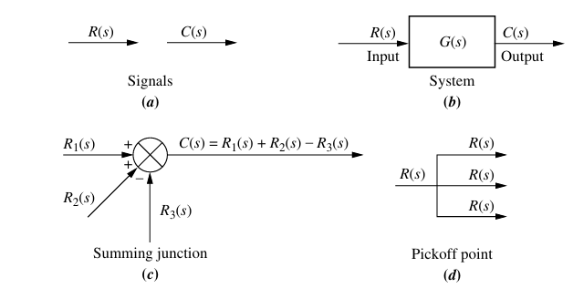
Block Diagram
Any system can be described by a set of differential equations or can be represented by the schematic diagram containing all components and their connections.
Block diagrams use single-line diagrams to show the flow of system variables from one block to another. A block may represent a single component or a group of components, beside this there are two new elements. These new elements are summing junctions and pickoff points.
Overall, Block diagrams are single line diagram, that is the flow of system variables from one block to another block is represented by a single line.

Slide 3
Block Diagram from Electrical System
Procedure to Draw block Diagram From Electrical Circuit:
1. Apply circuit laws (Ohm’s law, Kirchhoff’s laws) to each component with Laplace Transform (Assume Zero Initial Conditions).
2. Do circuit operation(Current and Voltage) step by step from input to output.
3. Now draw block diagram of each operation.
4. Now just add each block one after another in serial (Best possible way to arrange from last equation).

Slide 4
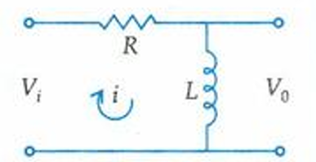
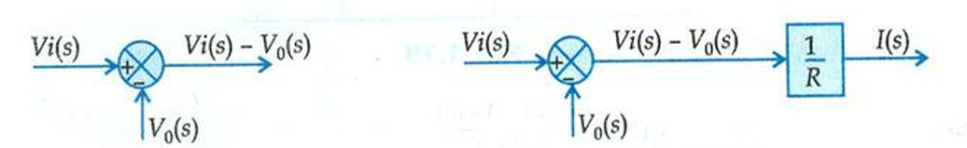
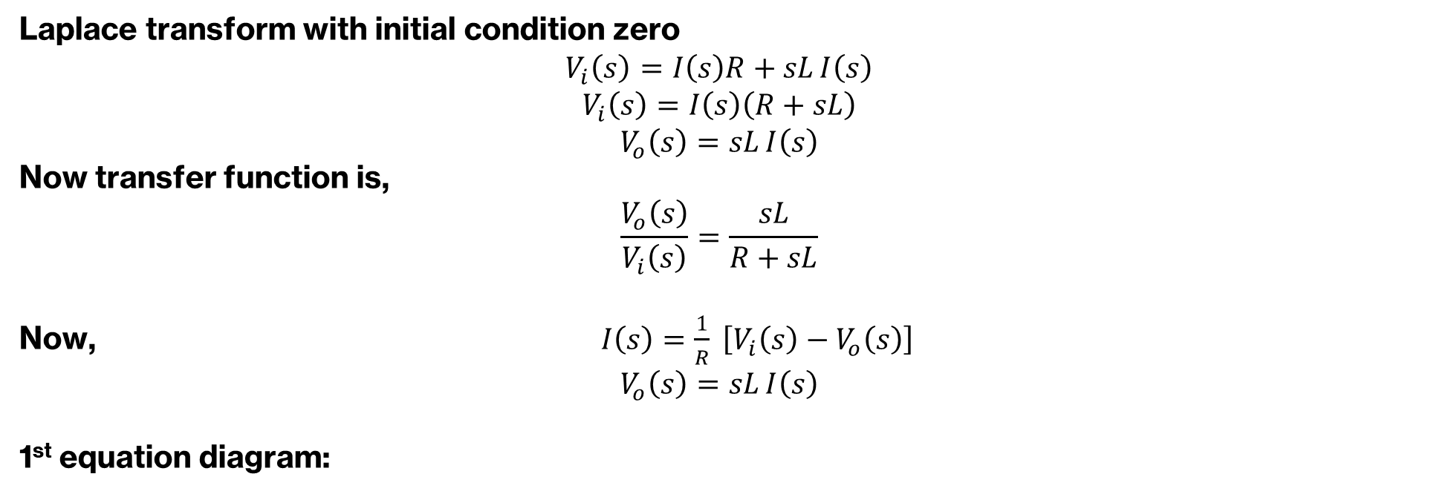
Block Diagram from Electrical System: Example 01
Laplace transform with initial condition zero
$$V_{i}\left(s\right)=I\left(s\right)R+sL I\left(s\right)$$
$$V_{i}\left(s\right)=I\left(s\right)\left(R+sL\right)$$
$$V_{o}\left(s\right)=sL I\left(s\right)$$
Now transfer function is,
$$\frac{V_{o}\left(s\right)}{V_{i}\left(s\right)}=\frac{sL}{R+sL}$$
Now, $I\left(s\right)=\frac{1}{R} \left[V_{i}\left(s\right)−V_{o}\left(s\right)\right]$
$$V_{o}\left(s\right)=sL I\left(s\right)$$
1st equation diagram:

Slide 5
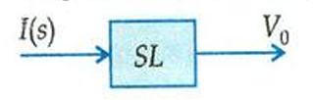
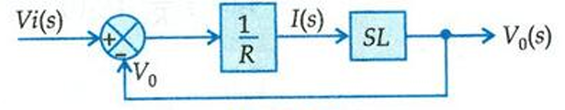
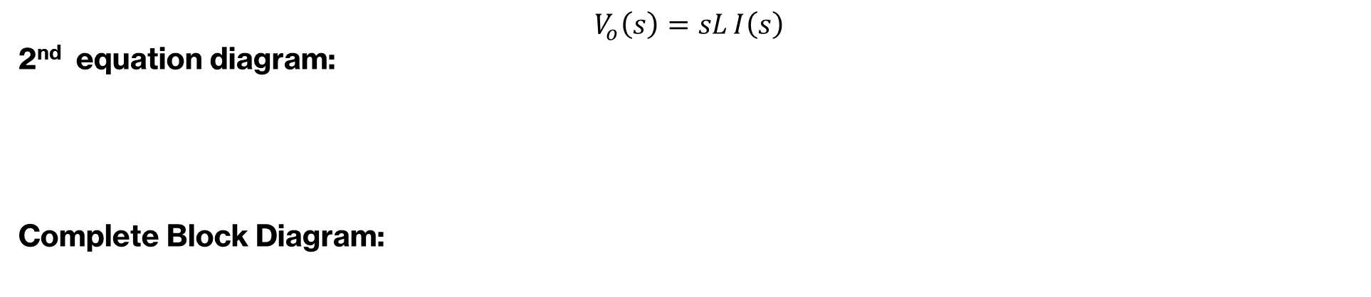
Block Diagram from Electrical System: Example 01
$$V_{o}\left(s\right)=sL I\left(s\right)$$
2nd equation diagram:
Complete Block Diagram:

Slide 6
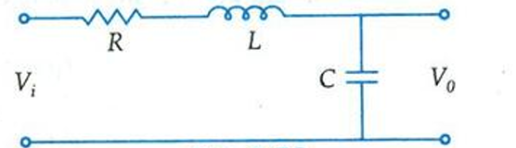
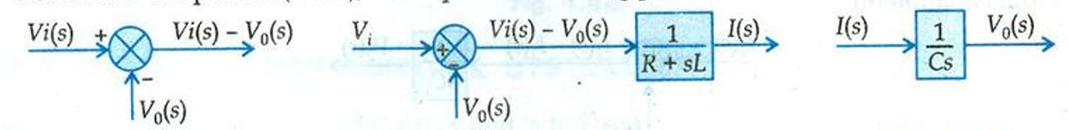
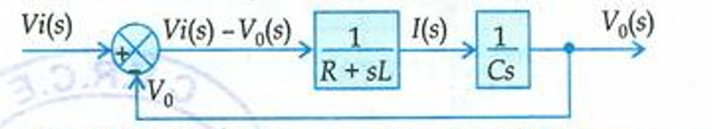

Block Diagram from Electrical System: Example 02
Here,
$$I\left(s\right)=\frac{V_{i}\left(s\right)−V_{o}\left(s\right)}{R+sL}$$
$$V_{o}\left(s\right)=\frac{1}{Cs} I\left(s\right)$$

Slide 7
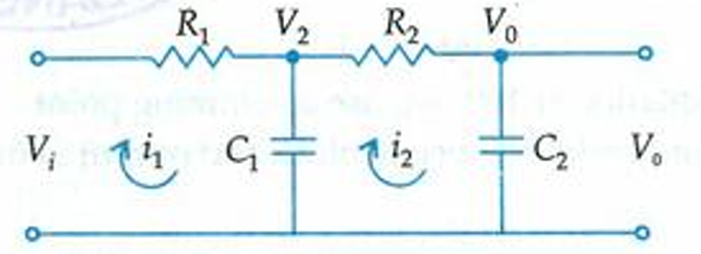
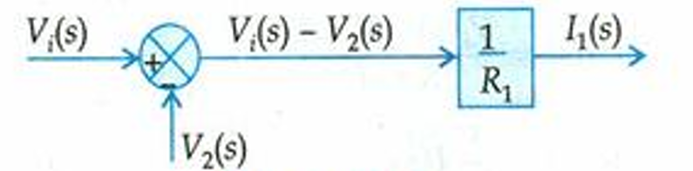
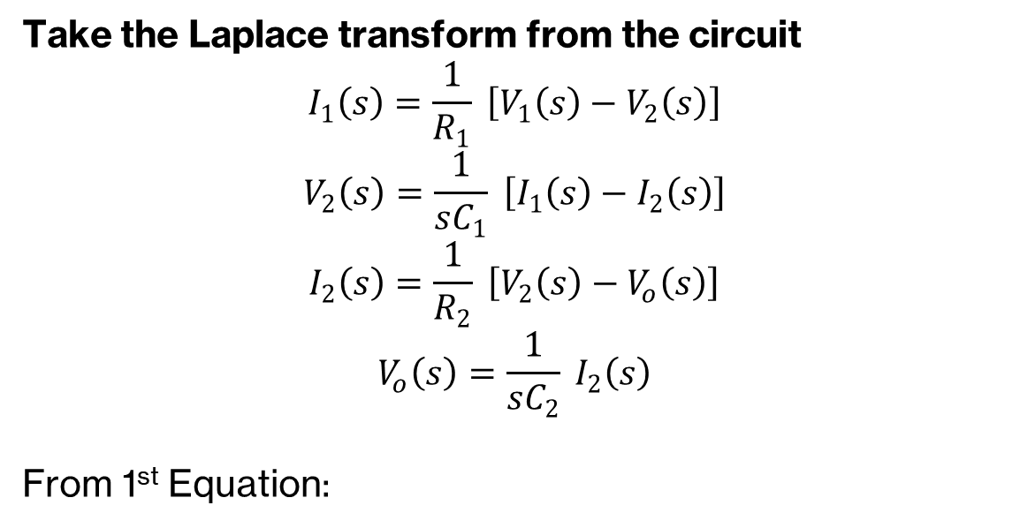
Block Diagram from Electrical System: Example 03
Take the Laplace transform from the circuit
$$I_{1}\left(s\right)=\frac{1}{R_{1}} \left[V_{1}\left(s\right)−V_{2}\left(s\right)\right]$$
$$V_{2}\left(s\right)=\frac{1}{sC_{1}} \left[I_{1}\left(s\right)−I_{2}\left(s\right)\right]$$
$$I_{2}\left(s\right)=\frac{1}{R_{2}} \left[V_{2}\left(s\right)−V_{o}\left(s\right)\right]$$
$$V_{o}\left(s\right)=\frac{1}{sC_{2}} I_{2}\left(s\right)$$
From 1st Equation:

Slide 8
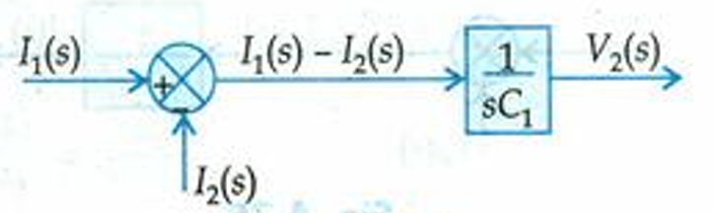
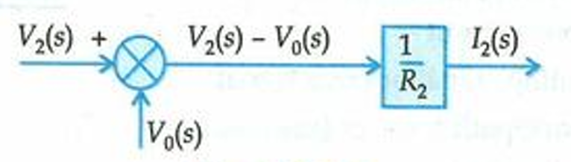
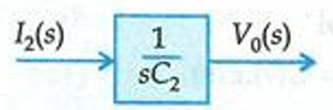
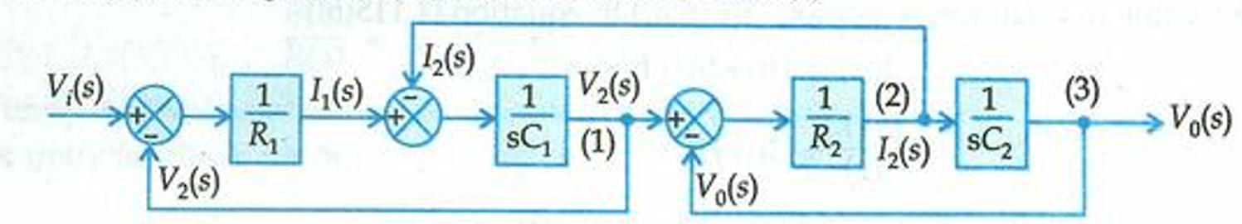
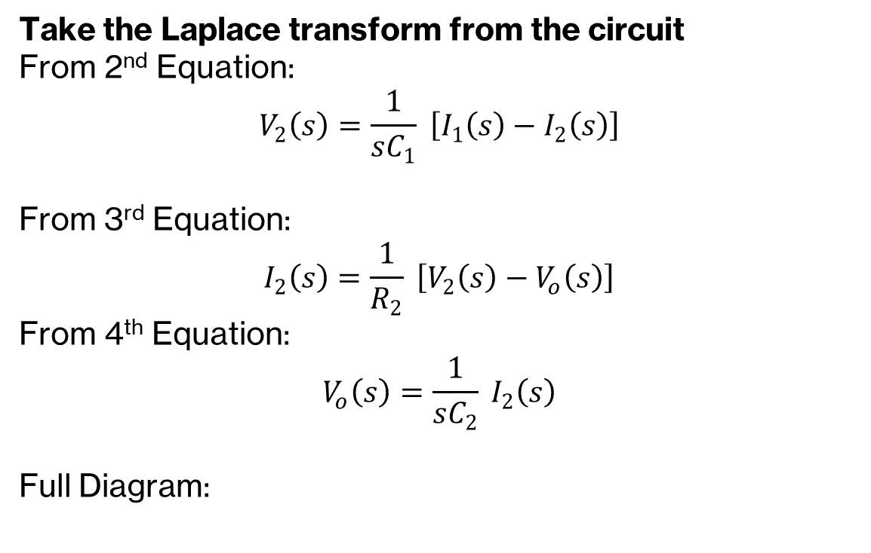
Block Diagram from Electrical System: Example 03
Take the Laplace transform from the circuit
From 2nd Equation:
$$V_{2}\left(s\right)=\frac{1}{sC_{1}} \left[I_{1}\left(s\right)−I_{2}\left(s\right)\right]$$
From 3rd Equation:
$$I_{2}\left(s\right)=\frac{1}{R_{2}} \left[V_{2}\left(s\right)−V_{o}\left(s\right)\right]$$
From 4th Equation:
$$V_{o}\left(s\right)=\frac{1}{sC_{2}} I_{2}\left(s\right)$$
Full Diagram:

Slide 9
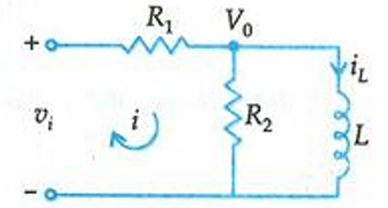
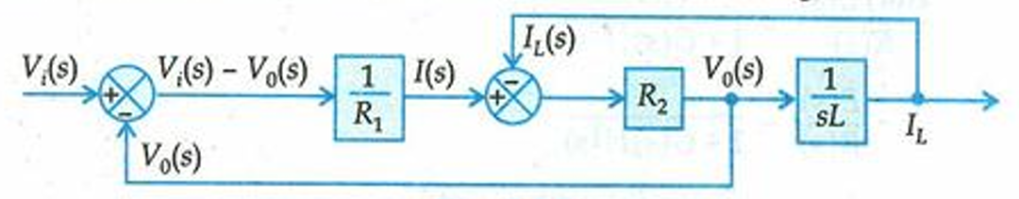
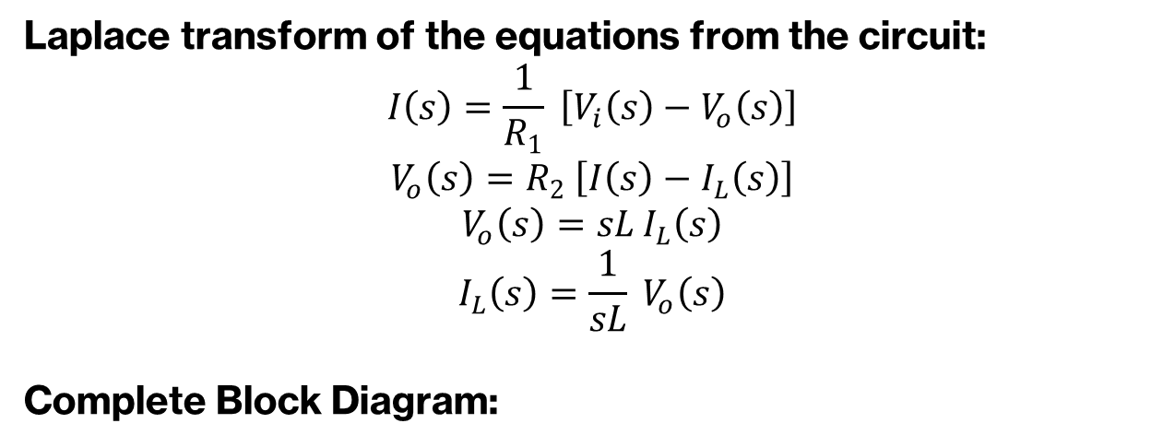
Block Diagram from Electrical System: Example 04
Laplace transform of the equations from the circuit:
$$I\left(s\right)=\frac{1}{R_{1}} \left[V_{i}\left(s\right)−V_{o}\left(s\right)\right]$$
$$V_{o}\left(s\right)=R_{2} \left[I\left(s\right)−I_{L}\left(s\right)\right]$$
$$V_{o}\left(s\right)=sL I_{L}\left(s\right)$$
$$I_{L}\left(s\right)=\frac{1}{sL} V_{o}\left(s\right)$$
Complete Block Diagram:

